Slide 1

This is tomorrow calling…

Slide 2


is proud to sponsor
Rugby World Cup 2015

Slide 3
The Radio Station has played a vital role in the history of Rugby, BT and the UK since the 1920s
It was responsible for creating and maintaining vital communication links all across the British Empire

Slide 4
The Radio Station has also been home to an Atomic Clock that ensured Greenwich Mean Time stayed accurate
Realising the site’s rich heritage provides inspiration for its future

Slide 5
Now Radio Station Rugby is entering a new chapter, and will grow into a dynamic community over the years to come.

Slide 6
Not just offering somewhere to live, but providing commercial spaces and jobs, helping companies and local communities to grow.

Slide 7
The site will include schools, a GP surgery, shops and green spaces, along with supporting infrastructure developments.
A flourishing new community.

Slide 8

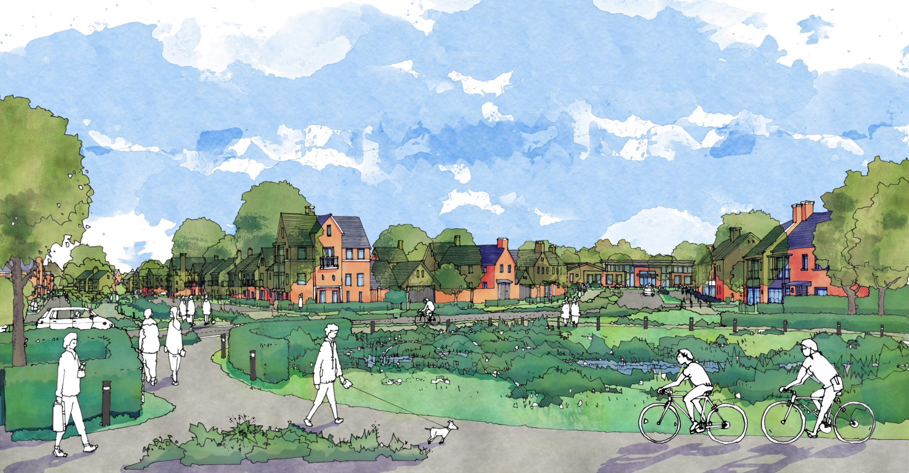
This is tomorrow calling…

Slide 9



Slide 10



Slide 11



Slide 12



Slide 13



Slide 14



Slide 15



Slide 16
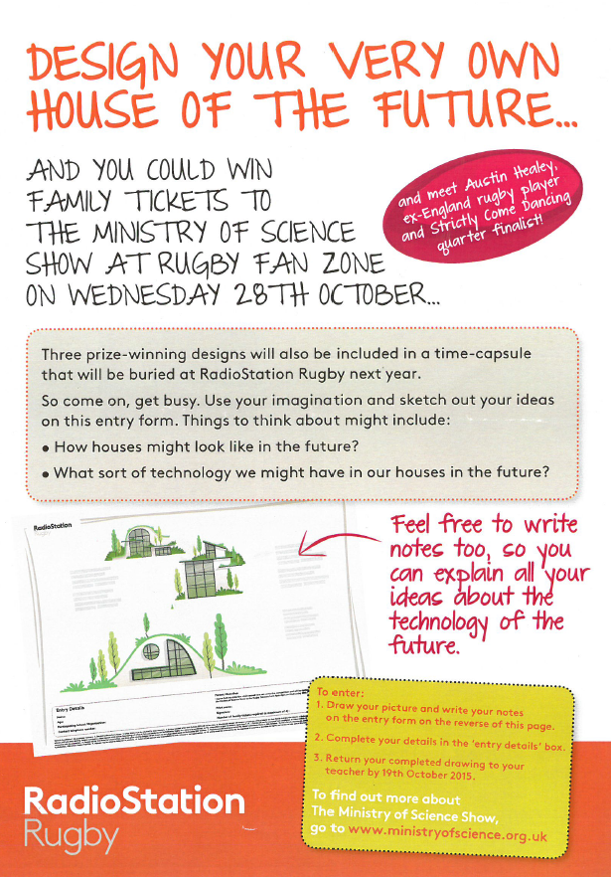
We recently ran a competition for local schoolchildren to design their House of the Future
We had some great entries
Can you spot yours?...

Slide 17
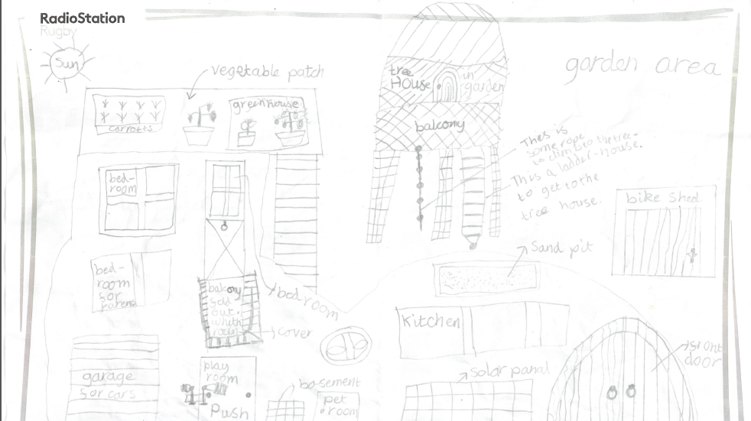
Kieran, Age 9

Slide 18
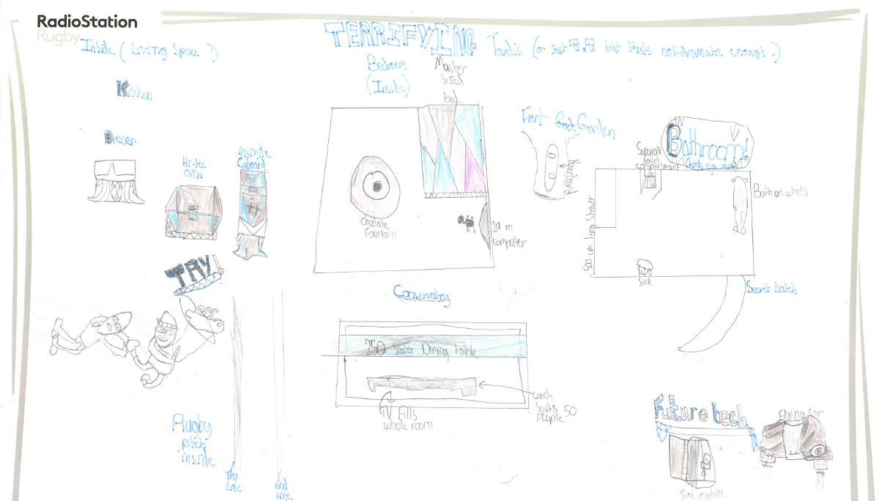
Finley, Age 8

Slide 19
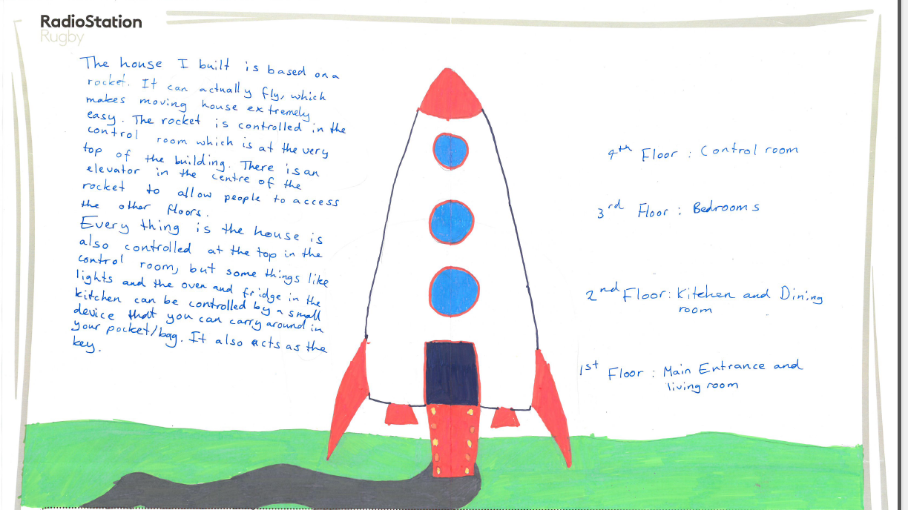
Jennifer, Age 12

Slide 20
Roland, Age 9

Slide 21
Anthony, Age 11

Slide 22
Samuel, Age 7

Slide 23
Annabelle, Age 9

Slide 24
Jayisha, Age 8

Slide 25
Maisha, Age 8

Slide 26
Reece, Age 7

Slide 27
Amber, Age 11

Slide 28
Holly, Age 9

Slide 29
Eashan, Age 8

Slide 30
Amy, Age 9

Slide 31
Sophia, Age 7

Slide 32
Theo, Age 8

Slide 33
Sophia, Age 7

Slide 34
Jack, Age 8

Slide 35
Christabel, Age 8

Slide 36
Jack, Age 8

Slide 37
Papison, Age 8

Slide 38
Lexi, Age 9

Slide 39
Mini, Age 8

Slide 40
Ansruta, Age 9

Slide 41
Isabella, Age 9

Slide 42
Please be aware that we are taking photographs for press and publicity purposes at today’s event.
If you do not wish your photograph to be used for these purposes,
please inform a member of RadioStation Rugby staff.

